Slide 1
RU
HallMenu RU
Rajshahi University Hall Dining Management App
Notes:
Welcome! This is HallMenu RU — a cross-platform mobile app for Rajshahi University's 17 residential halls.

Slide 2
Project Overview
❌ The Problem
✅ Our Solution
Students walk to dining halls not knowing what's cooked today
No real-time menu updates — information is static or unavailable
17 halls, thousands of students — no centralized digital system
Real-time menu visible on phone — before leaving room
Live food availability count with automatic status updates
Notices, feasts, and reviews — all in one mobile app
→
17
24
5
2
BaaS
Residential Halls
App Screens
Firestore Collections
User Roles
Firebase Backend
Notes:
Rajshahi University has 17 halls with thousands of students. Before this app, there was no digital menu system.

Slide 3
Technology Stack & Architecture
BaaS Architecture — no custom server
React Native + Expo
Firebase Auth
Cross-platform: one codebase → Android & iOS
Email-password login; bcrypt hashing; JWT token management
Expo Router
Repository Pattern
File-based routing; (student-tabs) & (mod-tabs) route groups for bottom nav
All Firebase CRUD centralized in repository.js
Firebase Firestore
NoSQL cloud database; real-time sync via onSnapshot()
Notes:
Firebase BaaS means no custom server needed. The Repository Pattern keeps all data access in one file.

Slide 4
Key Features
Hall Search & Filter
Real-Time Menu
Search by name, filter by Male/Female, see 'Updated today' badge
Breakfast/Lunch/Dinner with live item status and remaining count
Quick Status Update
Live Serve Count
Bulk status change: All Available / All Low / All Finished in one tap
Tap − to serve one portion; status auto-updates at 0 and ≤10
Food Reviews
Notice System
Star rating (1–5) + comment per food item, real-time via onSnapshot
Notices expire after set hours; getNotices() filters expired ones at read time
Feast Management
Daily Reset
Future-only feasts with date, menu, price and time range
Duplicate yesterday's menu or clear everything — one-tap workflow
Notes:
The app has ten major features. The most technically interesting ones are: the live serve count with automatic status transitions, the notice expiry system that filters at read time, the timezone fix using Asia Dhaka locale, and the onSnapshot real-time listener used for food reviews.

Slide 5
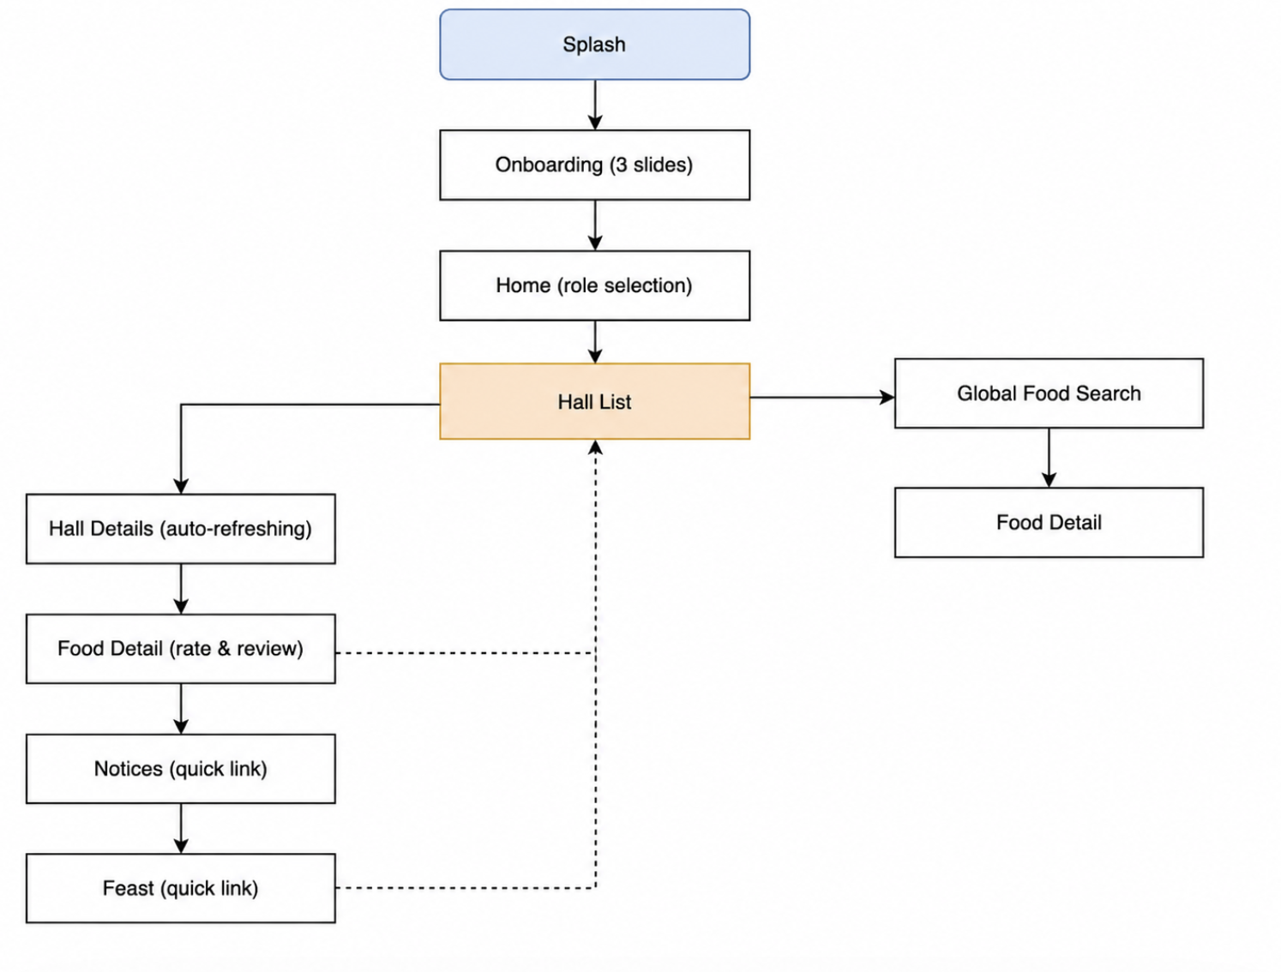
Student-Facing Screens

Slide 6
Splash Screen, Onboarding & Home
App entry flow — no Firebase calls here
Splash Screen
Onboarding Screen
Home Screen
Objective
Objective
Objective
Display app logo + animated loading dots; route to Onboarding after 2 s
3-slide intro to app features; first-run experience
Role selection gateway — Student or Moderator
UI & Features
UI & Features
UI & Features
RU logo box (green)
App name + tagline text
3 animated loading dots
2-second auto-navigation
No Firebase call
FlatList (pagingEnabled, scrollEnabled: false)
Dot indicator row
Next / Back / Skip / Get Started buttons
3 slides: Welcome, Meals, Updates
AsyncStorage hook commented (always shows)
Green brand card (RU logo)
Two role cards (Student / Moderator)
Role icon + name + desc + arrow
Student → HallList
Moderator → ModeratorRole
Nav: → Onboarding (router.replace)
Nav: → Home (router.replace)
Nav: Student → /HallList · Moderator → /ModeratorRole

Slide 7
Hall List Screen & Hall Detail Screen
Core student viewing experience
Hall List Screen
Hall Detail Screen
Objective: Browse all 17 halls with search + Boys/Girls filter
UI: FlatList, TextInput search bar, 3 filter chips, Feast & Notice quick cards
Feature: 'Updated today' badge — parallel Promise.all() reads all 17 menus
API: getMenu(hallId, today) × 17 concurrent calls via Promise.all()
DB: menus collection read; halls.js static list
Objective: Show today's complete Dining + Canteen menu for one hall
UI: Expandable accordion cards (Dining / Canteen), meal tabs (Breakfast/Lunch/Dinner), item rows with status badges
Feature: Each item is tappable → FoodDetailScreen; NOT_UPDATED badge shown when meal data absent
API: subscribeMenu(hallId, today) — real-time onSnapshot() listener
DB: menus/{hallId}_{dateKey} — reads dining & canteen sub-objects

Slide 8
Global Food Search Screen
Find any food item across all 17 halls instantly
🔍 Global Food Search Screen
Objective: Search for any food item by name across all 17 halls at once
UI: TextInput search bar + FlatList results; mirrors HallListScreen's search pattern
Feature: Fetches all 17 halls once on load, then filters client-side — instant results
API: getMenu(hallId, today) × 17 concurrent calls via Promise.all()
Entry point: Linked from a quick-link card on HallListScreen; routed via _layout.js
DB: menus collection read across all halls; halls.js static list

Slide 9
Food Detail · Feast · Notices Screens
Review system + content viewing
Food Detail Screen
Feast Screen
Notices Screen
Objective: View food info, submit star rating + comment, see all reviews
UI: Food info card (emoji, price, status badge, avg rating), 5-star selector, TextInput comment, review list
API: addDoc(foodReviews) on submit; onSnapshot() real-time review listener
DB: foodReviews — hallId + dateKey + itemName compound query (needs composite index)
Validation: Rating > 0 required; comment must not be empty; Error: Alert on Firestore fail
Objective: Students see upcoming dining & canteen feasts
UI: Two accordion sections (Dining / Canteen), feast card with hall name, date, menu, price, countdown badge
Feature: Past feasts filtered — only f.date >= today shown
API: getFeasts('dining') + getFeasts('canteen') via Promise.all()
DB: feasts collection; filter by role field
Objective: Students view active dining and canteen notices
UI: Two accordion sections, notice card with type badge (emoji + color), title, message, hall, timestamp, expiry
Feature: Expired notices auto-filtered at read time using createdAt + expiresIn hours
API: getNotices('dining') + getNotices('canteen') via Promise.all()
DB: notices collection; type field used as query filter
Security: No auth required — any student can review. Future: Student ID gate.
Future: push notification 1 day before feast date.
Error: Network fail → empty list with no crash. Graceful degradation.

Slide 10
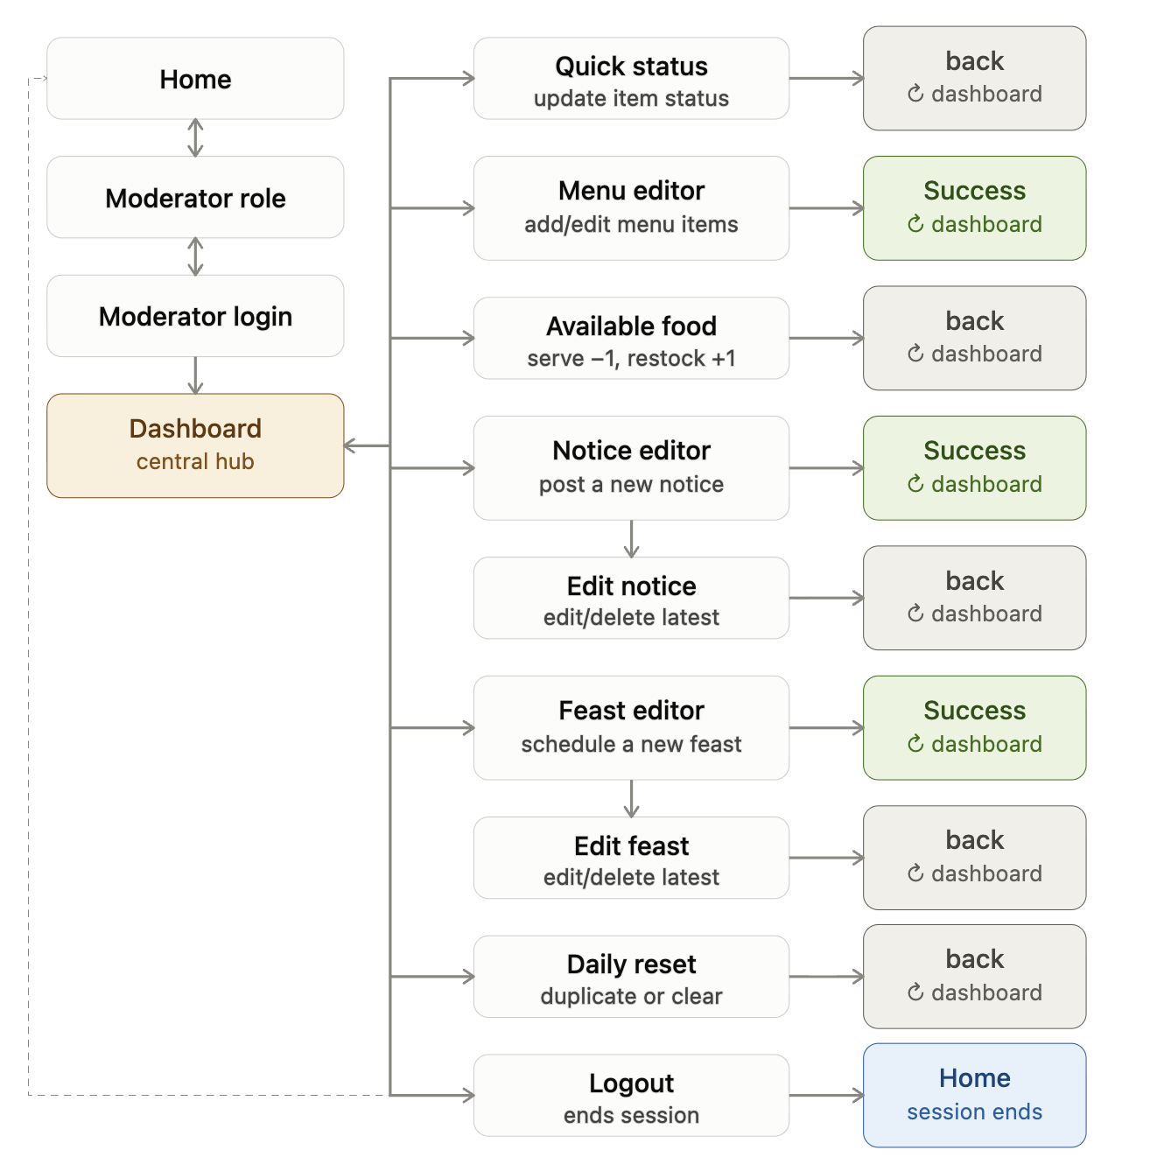
Moderator-Facing Screens

Slide 11
Moderator Role, Login & Dashboard
Authentication flow + control panel
🛡️ Moderator Role Screen
🔐 Moderator Login Screen
📊 Moderator Dashboard
Objective: Select Dining or Canteen role to proceed
UI: Two role cards with colors (green/purple); Modal for password re-confirmation when session exists
Feature: auth.currentUser check — if session active, show password confirm modal instead of login page
API: getModeratorData(uid), signInWithEmailAndPassword() for re-auth
Security: Password must be re-entered even with existing session
Objective: Email + password login for assigned moderator
UI: Role badge, email & password TextInput, eye toggle, hint box showing email format
Feature: Auto-appends @rudining.com if @ not present; role mismatch check after login
API: signInWithEmailAndPassword(auth, email, pass) + getModeratorData(uid)
Validation: Empty field alert; role !== expected role → Alert + setLoading(false)
Objective: Central hub for all moderator actions
UI: Green/purple header card with hall name, role badge, date; Pressable menu cards with icon + description
Feature: isDining flag drives separate DINING_ITEMS vs CANTEEN_ITEMS menu lists
API: signOut(auth) on logout → router.replace('/Home')
Security: All params (hallId, role) passed via Expo Router params — no local storage

Slide 12
Menu Editor & Quick Status Screens
Primary content management tools
✏️ Menu Editor Screen (Dining)
⚡ Quick Status Screen (Dining)
Objective: Create/edit Breakfast, Lunch, Dinner menus with items, prices, counts, and status
UI: 3 meal tabs, time TextInput, per-item card (name/price/count/status chips), Note field, Preview, Save
Feature: Preview renders student-side view before save; immutable state updates with spread operator
API: getMenu() on load → saveDiningMenu() → logUpdate() on save
Validation: Price ≥ 0 numeric check; count ≥ 0; blank items filtered on save
Objective: Rapidly update item status (Available / Low / Finished) without editing full menu
UI: Per-meal card, 'All Available / Low / Finished' bulk buttons, count TextInput, 3-chip status row per item
Feature: Bulk Apply sets all items in a meal to one status simultaneously
API: getMenu() on load → quickUpdateDining(hallId, today, meals) on save
Validation: Non-empty count; numeric parsing handled on save via Number()
Canteen version: CanteenMenuEditorScreen — same pattern, single 'Canteen' section, no meal tabs.
Canteen version: CanteenQuickStatusScreen — same logic, single items array, no meal loop.

Slide 13
Available Food · Notice Editor · Feast Editor
Live serving + content publishing
🥘 Available Food Screen
📢 Notice Editor Screen
🎉 Feast Editor Screen
Objective: Real-time stock management — serve food and auto-reduce count
UI: Info banner, meal tabs (dining) or flat list (canteen), item cards with '−' serve & '+1' restock buttons
Feature: '−' serves (count−1, auto status); outlined '+1' restocks — fixes accidental over-serving
API: getMenu() on load; upsertMenu() after each serve (updates entire dining/canteen object)
Known Issue: Race condition if two moderators serve simultaneously — fix: Firestore increment()
Objective: Post a new dining or canteen notice with type, title, message, expiry
UI: Horizontal type chip selector (delay/shortage/closure/update/other), title & message TextInput, expiry hours, 'Edit Notice' secondary button
Feature: Selected type shown with emoji badge; 'Edit Notice' links to EditNoticeScreen
API: postNotice(hallId, hallName, role, payload) → addDoc() to notices collection
Validation: message.trim() must not be empty; expiresIn defaults to 6 if omitted
Objective: Schedule a new feast event with date, title, time range, menu, price
UI: 5 TextInput fields; 'Edit Feast' secondary button; Save Feast primary button
Feature: Menu entered comma-separated → stored as Array<String> in Firestore
API: addFeast(hallId, hallName, role, payload) → addDoc() to feasts collection
Validation: date and title required; price parsed as Number; empty menu items filtered

Slide 14
Daily Reset · Edit Screens
Day management + history tracking
🔄 Daily Reset Screen
📝 Edit Notice / Edit Feast
Objective: Start a new day by copying yesterday's menu or clearing everything
UI: Two action cards — 'Duplicate Yesterday' (green) + 'Clear All' (red/danger)
Feature: resetItemsForDuplicate() strips stale count → null & status → available; keeps name/price/time
API: duplicateYesterday() + upsertMenu() for clear (sets empty items arrays)
Validation: Alert confirmation before both actions; 'No Data' alert if yesterday's doc missing
Objective: Browse all hall notices/feasts as cards, then edit or delete any one
UI: List-mode cards (Edit/Delete each) → tap opens pre-filled edit form + Save Changes button
Feature: Expired feasts shown dimmed below; upcoming feasts sorted to the top
API: getNotices/getFeasts → filter by hallId → updateNotice/updateFeast or deleteNotice/deleteFeast
Note: Same list-then-edit pattern used for both Edit Notice and Edit Feast screens

Slide 15
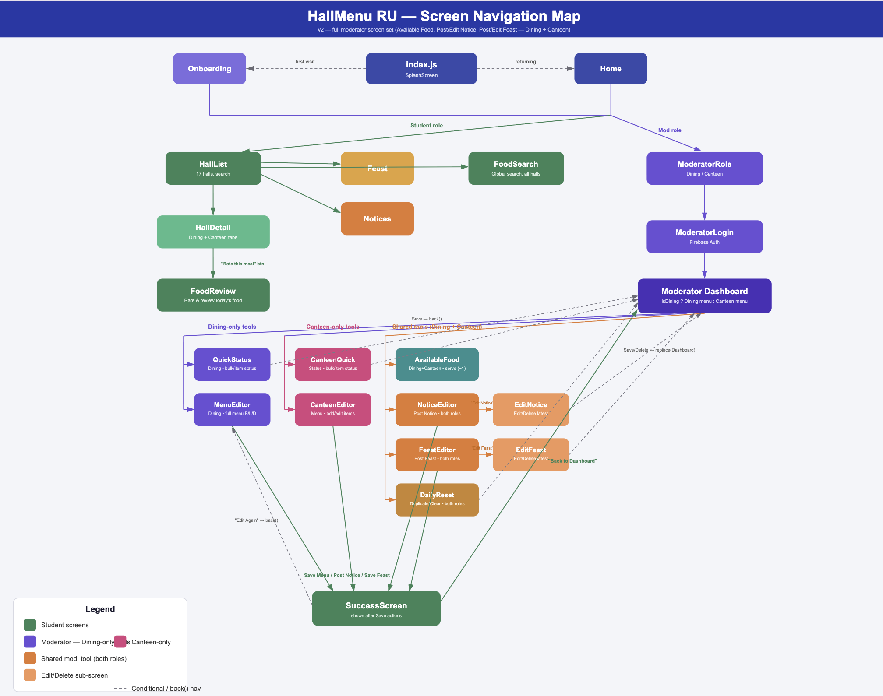

Slide 16
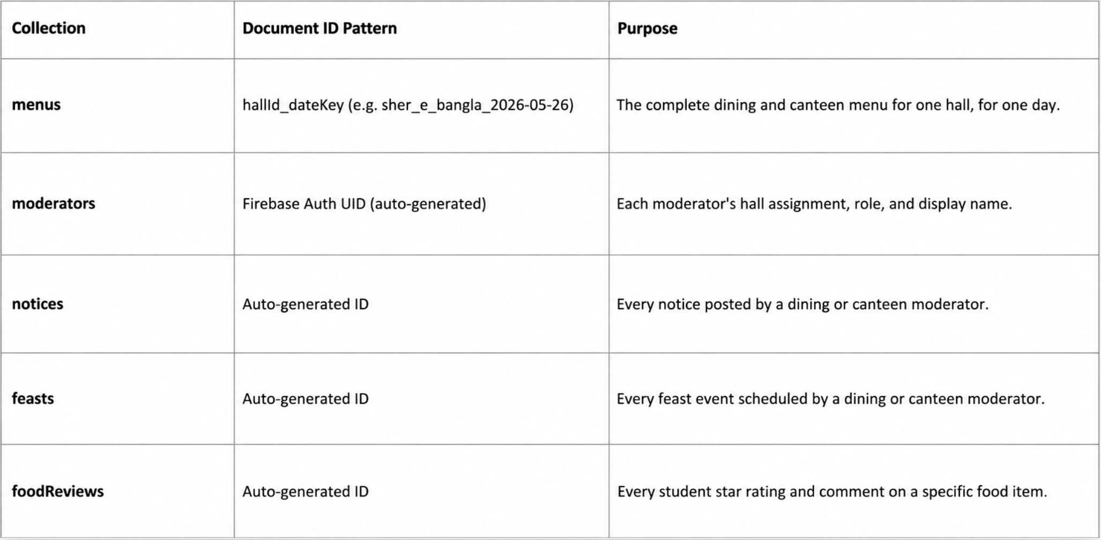
08 · Database
Database Overview — Firebase Firestore
menus
hallId | hallName | name | role (dining/canteen) | email | createdAt
l.
notices
.
feasts
updateHistory
hallId | moderatorName | role | action | timestamp
foodReviews
Notes:
Firestore has 6 collections. The menus collection is the most critical — its document ID is hallId underscore dateKey, giving O(1) lookup. Each document contains both dining and canteen data for that day. The foodReviews collection requires a composite index in the Firebase console because it uses multiple where clauses and an orderBy. All other lookups are simple single-document or single-where reads.

Slide 17
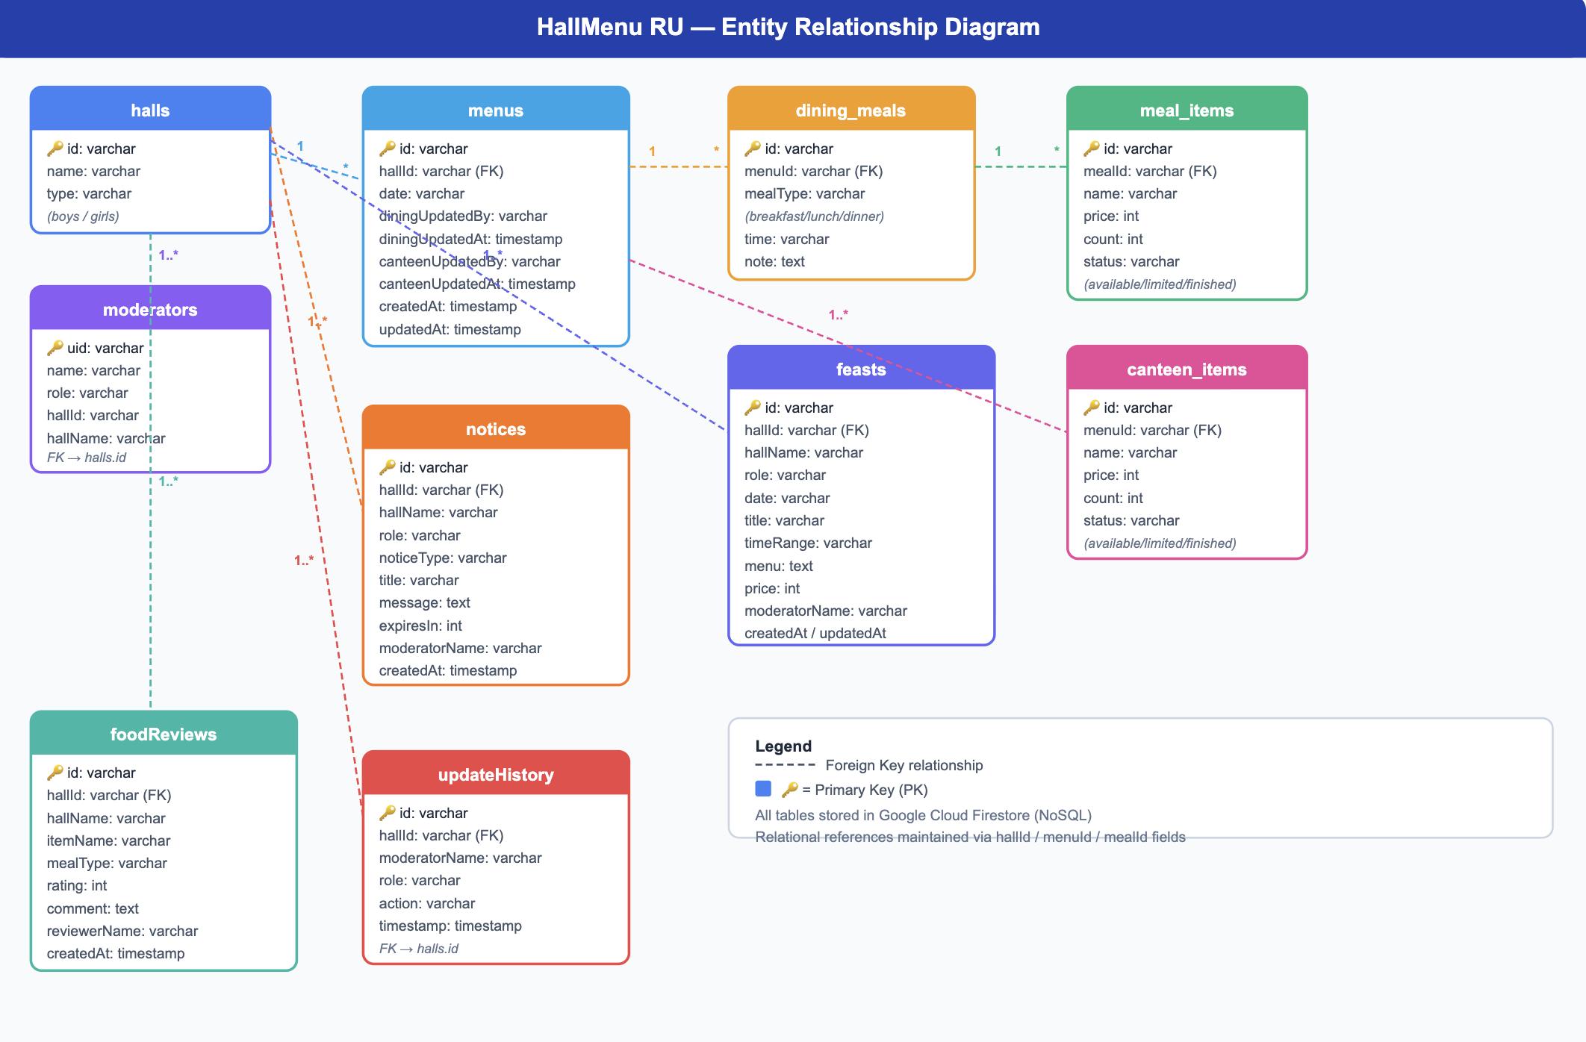

Slide 18
System Architecture
Firebase BaaS (Backend as a Service) Architecture — No Custom Server Required
UI Layer
src/screens/ — React Native components, useState, useEffect, business logic
Route Layer
src/app/ — expo-router file-based routing, thin wrapper components
Data Layer
src/data/repository.js — ALL Firebase CRUD operations centralized (Repository Pattern)
Firebase SDK
JavaScript SDK — HTTPS requests, real-time listeners, auth token injection
Firebase Cloud
Authentication | Firestore Database | Security Rules — hosted on Google servers
Notes:
The architecture uses Firebase BaaS — there is no custom backend server. The frontend is layered: screens handle UI, expo-router handles navigation, and repository.js centralizes all Firebase calls. The most important design decision is the composite document ID: hallId underscore dateKey. This gives O(1) lookup for any hall's menu on any date — no query needed.

Slide 19
Security Features
Firebase Authentication
Password Security
Email-password auth managed by Firebase. JWT token auto-injected in every SDK request. Token expires in ~1 hour and auto-refreshes.
Firebase hashes all passwords with bcrypt. Plain-text passwords are never stored. Comparison happens server-side.
Role Enforcement
Re-authentication Modal
Login screen checks modData.role !== role. Wrong role → Login Failed alert. Prevents dining moderator accessing canteen dashboard.
On session resume, ModeratorRoleScreen requires password re-entry before dashboard access. Prevents unauthorized access on shared devices.
Firestore Security Rules
Input Validation
Rules deployed to prevent unauthorized writes. Public read for menus/notices/feasts. Write requires request.auth != null.
Price and count validated as non-negative numbers. Empty item names filtered out. SQL injection impossible — Firestore uses parameterized SDK calls.
⚠️ Known Limitation: foodReviews has no authentication — any user can submit a review. Role enforcement is client-side only; server-side Firestore Rules are the production fix.
Notes:
The app has six security measures. Firebase handles bcrypt password hashing and JWT token management automatically. The role mismatch check on login prevents cross-role access. The re-authentication modal on the Role screen prevents dashboard access on shared devices. Firestore Security Rules enforce server-side access control. The main known limitation is that food reviews are unauthenticated.

Slide 20
Future Improvements
Push Notifications
Offline Support
Notify students when today's menu is posted or when a feast is announced.
Replace getFirestore() with initializeFirestore(CACHE_SIZE_UNLIMITED) for offline menu browsing.
Race Condition Fix
Student Review Auth
Replace manual count-- with Firestore atomic increment(-1) to fix concurrent serve conflicts.
Require Student ID login before review submission to prevent spam and anonymous abuse.
Analytics Dashboard
Advance Menu Planning
Track which food items get highest ratings and most reviews across all halls.
Allow moderators to set tomorrow's menu tonight — auto-visible at midnight Dhaka time.
Notes:
The eight planned improvements span different categories. The most impactful for users would be push notifications and offline support. The most critical technically is fixing the race condition in the serve count using Firestore's atomic increment. Student authentication for reviews would prevent abuse. An admin panel would give university management a bird's-eye view of all 17 halls.

Slide 21
Summary
1
23 Screens — Complete student + moderator feature set across dining & canteen roles
2
Firebase BaaS — No custom server — auth, database, security rules from one platform
3
Repository Pattern — All CRUD centralized in repository.js — maintainable & testable
4
Timezone Fix — Asia/Dhaka-aware getTodayKey() prevents midnight date shift bugs
5
Real-time Sync — onSnapshot() delivers live menu to students as moderator types
6
Honest Limitations — No offline support, no push notifications — all fixable
Thank you
Notes:
Close with confidence. Mention you know the limitations and how each would be fixed in production.

